Slide 1
The Scottish Election
Nuclear Weapons Debate
In this presentation:
UK and Scottish Governments do not agree on Trident
Devolved and Reserved Powers
Defence - a reserved power - The Ministry of Defence
Who are the candidates for your area?
Political parties’ views on Trident:
Conservative, Green, Labour, Liberal Democrat, SNP
Comparison table

Slide 2
UK and Scottish Governments disagree
The current UK and Scottish Governments take different positions on nuclear weapons.
UK Gov - supports maintaining the nuclear deterrent.
Scottish Gov - opposes nuclear weapons and has called for their removal from Scotland.
Defence is a reserved power.
Trident, the UK’s nuclear weapons system, is based at Faslane, 30 miles from Glasgow.

Slide 3
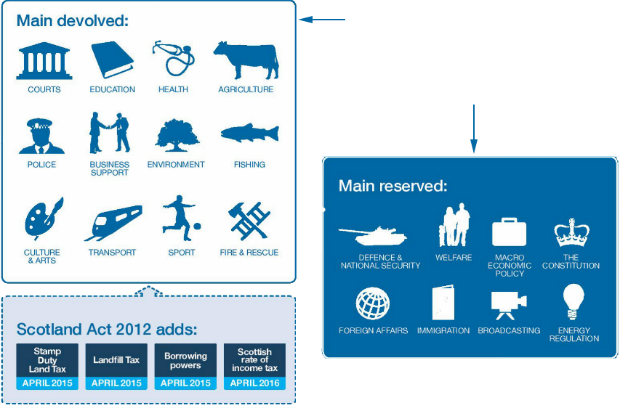
Devolved or Reserved?
Notes:
Image from https://www.gov.uk/government/news/scottish-independence-referendum-whats-next

Slide 4
Defence - a Reserved Power
The UK Ministry of Defence 🔗 About us - Ministry of Defence (.gov.uk)
“ We work for a secure and prosperous United Kingdom with global reach and influence. We will protect our people, territories, values and interests at home and overseas, through strong armed forces and in partnership with allies, to ensure our security, support our national interests and safeguard our prosperity “
“ Who we are
The Ministry of Defence has trained and untrained personnel in the three Services and its civilian workforce including Royal Fleet Auxiliaries, Trading Funds (such as the UK Hydrographic Office) and locally engaged civilians who support our presence overseas.
The UK regular forces comprise full time trained and untrained personnel in the:
Royal Navy
British Army
Royal Air Force
The Royal Navy are responsible for the 4 Vanguard class submarines that carry the Trident Missiles. The RN has seven other nuclear powered but not nuclear armed submarines “

Slide 5
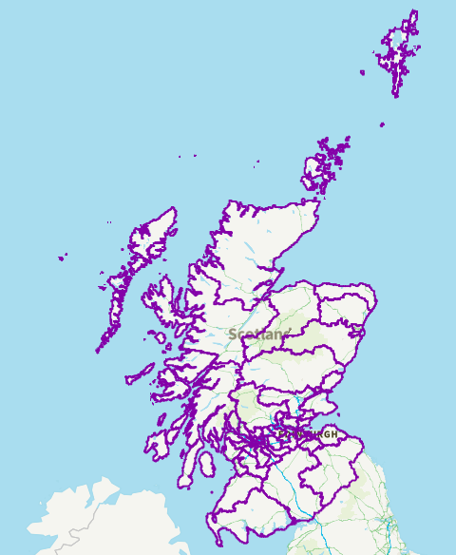
Who are the candidates in your area?
Candidates want to be elected to represent their constituency.
The people who live there are called constituents.
How do they try to get people to vote for them?
Manifesto
Hustings
Social media
Televised debates
Door-to-door canvasing
Leaflets/posters
Find out the candidates in your area:
🔗 whocanivotefor.co.uk

Slide 6
Political parties’ views on Trident
Although Defence is a reserved power, some political parties in Scotland take a position on Nuclear Weapons - as those weapons are sited in Scotland.
There is also a cross-party group on nuclear disarmament in the Scottish Parliament: 🔗 parliament.scot Nuclear Disarmament - Cross Party Group
Quite often party members will disagree with their party policy on Nuclear Weapons – especially on issues of morality.
The next few slides present previous published positions of political parties contesting the Scottish Parliament election, on the topic of nuclear weapons.

Slide 7
Conservatives' Position on nuclear weapons
“ We will always be steadfast in our support for our Trident nuclear deterrent and have invested in its modernisation, including a nuclear skills package worth up to £763 million by 2030. “
🔗 https://public.conservatives.com/static/documents/GE2024/Conservative-Manifesto-GE2024.pdf
"National interest means a strong military and a strong economy … peace is only obtained through strength … We must do what it takes to protect Britain. That means not just our independent nuclear deterrent, but also the ability to protect our critical national infrastructure - at home and under the sea. It means having the capability required to contribute meaningfully to NATO-led deterrence in Europe.“
🔗 https://www.conservatives.com/news/kemis-speech-on-foreign-policy
(The Scottish Conservative Party’s position on Nuclear Weapons currently aligns with the Conservative Party’s position quoted above).

Slide 8
Scottish Greens’ position on nuclear weapons
“ For far too long the Ministry of Defence has played fast and loose with these weapons of mass slaughter, throwing billions of pounds at private contractors whilst failing to maintain their own bases and equipment.
There are few sites in the world as dangerous as Coulport, where the UK’s nuclear warheads are kept. An accident or shoddy maintenance there could have catastrophic consequences.
For people who live in the local area – the communities I represent – it was particularly chilling to find out years later that this leak happened - and that it was initially covered up to save the Navy the embarrassment.
The nuclear arsenal at Faslane and Coulport doesn’t exist to keep us safe. The UK pours obscene amounts of money into these weapons rather than into our public services or tackling crises like the climate emergency for one reason, to keep its seat on the UN Security Council and keep up the delusion that this country is still a global superpower. “
🔗 https://greens.scot/blog/no-nukes-in-an-independent-scotland

Slide 9
Labour’s position on nuclear weapons
“ Our commitment to the UK’s nuclear deterrent is absolute. It is a vital safeguard for the UK and our NATO allies. As the party that founded NATO, we maintain our unshakeable commitment to the alliance, and we will apply a NATO test to major defence programmes to ensure we meet our obligations in full.
In recent years, threats to our safety and security have multiplied and diversified. To ensure the UK is fully prepared to deal with these interconnected threats, Labour will conduct a Strategic Defence Review within our first year in government, and we will set out the path to spending 2.5 per cent of GDP on defence. “
🔗 https://www.gov.uk/government/news/this-labour-government-will-have-a-nato-first-defence-strategy-article-by-the-foreign-secretary-and-defence-secretary
(The Scottish Labour Party’s position on Nuclear Weapons currently aligns with the Labour Government’s position quoted above).

Slide 10
Liberal Democrats’ position on nuclear weapons
Policy changed in March 2026. The March 2023 position supported:
“Maintain a minimum, credible nuclear deterrent” and “continuous at-sea deterrence”, while remaining open to “a future move down ... to a medium-responsiveness posture ... to demonstrate leadership on nuclear disarmament” and declaring a “policy of ‘No First Use’ for the UK’s nuclear deterrent“.
🔗 https://www.libdems.org.uk/news/article/the-uks-nuclear-deterrent-our-new-policy March 2023
The March 2026 policy prioritises a UK-manufactured deterrent independent of the USA:
“… the real question is not whether we should build a sovereign British nuclear deterrent. The question is what happens if we don't. Trident ... will need replacing in 2042. If we haven’t built our own capability before then, … who knows what terms [the US] will offer? … cannot afford to leave our national security to chance … ending our dependence on Trump’s America”
🔗 https://www.libdems.org.uk/news/article/britains-nuclear-deterrent-depends-on-trump-its-time-to-change-that March 2026
(The Scottish Liberal Democrat position currently aligns with the policy quoted above).

Slide 11
The SNP’S position on nuclear weapons
“ Westminster’s commitment to nuclear weapons leaves other aspects of our defence weakened.
Nuclear weapons are wrong strategically, morally and financially.
Westminster’s irresponsible obsession with nuclear weapons is an immoral and ruinous expense.
Current estimates are that the nuclear deterrent costs us around £2.7 billion a year – money that could be spent on new hospitals, schools and uplifting armed forces’ pay.
We support long-term investment in His Majesty’s Naval Base Faslane as a conventional military base.
The SNP’s position on nuclear weapons is clear; The SNP, in the event of independence, would use Scotland’s new sovereign powers to remove them from Scottish territory.
The SNP would advocate for the withdrawal of nuclear weapons as soon as can safely be undertaken. “
🔗 https://www.snp.org/policies/what-is-the-snp-position-on-nuclear-weapons/

Slide 12
Comparison Table
Political Party | Supports Trident (UK Nuclear Weapons) | Against Trident
Conservative | x
Green |  | x
Labour | x
Lib Dem | x
SNP |  | x

