Slide 1

The United nations

Slide 2
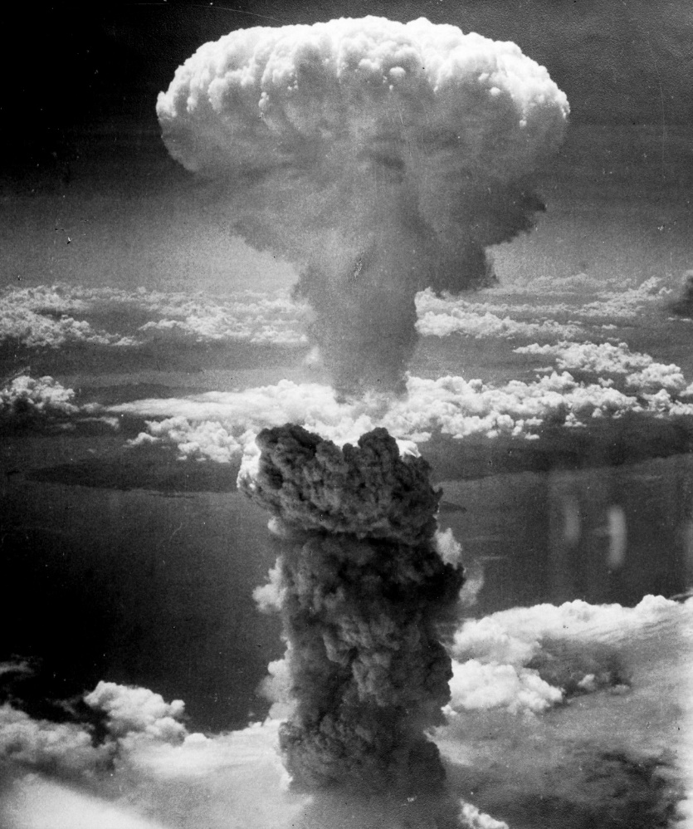
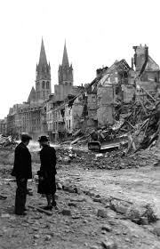
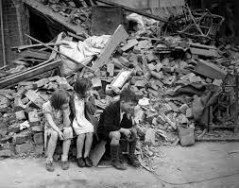
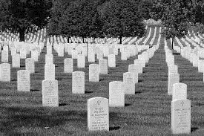
The United Nations
An International organization founded in 1945 after World War II with a central mission: the maintenance of international peace and security
UN Charter is the foundational treaty signed in 1945
The UN now has 193 member states
Notes:
There are 194 universally recognized countries (193 members of the UN plus the Vatican [Holy See]). Places like Palestine, Kosovo and Taiwan are partially recognized which increase the count. The State of Palestine is often included but it is only recognized by 138 UN members. Kosovo is also often included but is only recognized by 97 UN members https://www.worldatlas.com/articles/how-many-countries-are-in-the-world.html

Slide 3
The Role of the UN
Maintain international peace and security
Protect human rights
Deliver humanitarian aid
Promote sustainable development (SDGs)
Uphold international law
Notes:
https://www.un.org/en/sections/what-we-do/

Slide 4
Part 1: the parts of the un

Slide 5
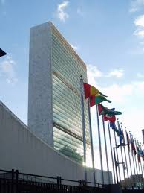
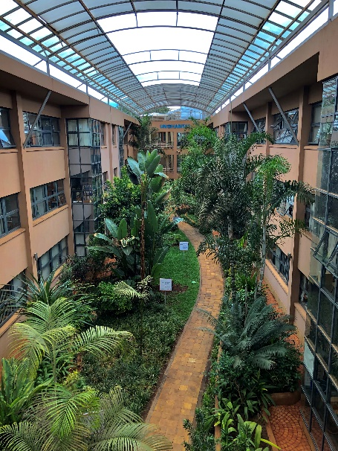
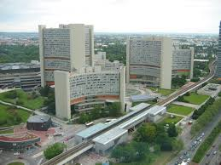
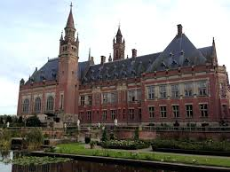
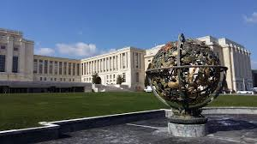
Main UN buildings
Vienna Office
International Court of Justice, the Hague, the Netherlands
Geneva office
Nairobi Office
UN Headquarters New York

Slide 6
The UN Structure
The Security Council
The Economic and Social Council
The General Assembly
The General Assembly
The Trusteeship Council
The International Court of Justice
The UN Secretariat

Slide 7
The UN Structure
The Security Council
The Economic and Social Council
The General Assembly
The General Assembly is the main decision making part of the United Nations. All the member countries are invited to participate and debate issues around peace, finance and culture.
The Trusteeship Council
The International Court of Justice
The UN Secretariat

Slide 8
The UN Structure
The Security Council
The Economic and Social Council
The General Assembly
In the Economic and Social Council 54 representatives discuss developing countries and the wellbeing of the world’s citizens. They write advice for the governments of the members of the United Nations
The Trusteeship Council
The International Court of Justice
The UN Secretariat

Slide 9
The UN Structure
The Security Council
The Economic and Social Council
The Trusteeship Council used to supervise Australia, Belgium, the UK, France, the USA, South Africa and New Zealand when they ruled places that used to be part of European Empires. These places now rule themselves and the Council hasn’t met since 1994 but still exists on paper.
The General Assembly
The Trusteeship Council
The International Court of Justice
The UN Secretariat

Slide 10
The UN Structure
The Security Council
The Economic and Social Council
The General Assembly
The Court decides when international laws have been broken and gives legal advice for the other parts of the United Nations.
The Trusteeship Council
The International Court of Justice
The UN Secretariat

Slide 11
The UN Structure
The Security Council
The Economic and Social Council
The General Assembly
The Secretariat does the behind-the-scenes work to keep the UN running. They provide research, translation and public relations services for the other parts of the UN. The head of the Secretariat is the Secretary-General.
The Trusteeship Council
The International Court of Justice
The UN Secretariat
Notes:
chief administrative officer and head of the Secretariat. António Guterres (2020)

Slide 12
The UN Structure
The Security Council
The Economic and Social Council
China, France, Russia, the UK, the USA and 10 other temporary members make decisions about war, international conflict and military threats. All UN members must follow the decisions this council makes.
The General Assembly
The Trusteeship Council
The International Court of Justice
The UN Secretariat

Slide 13
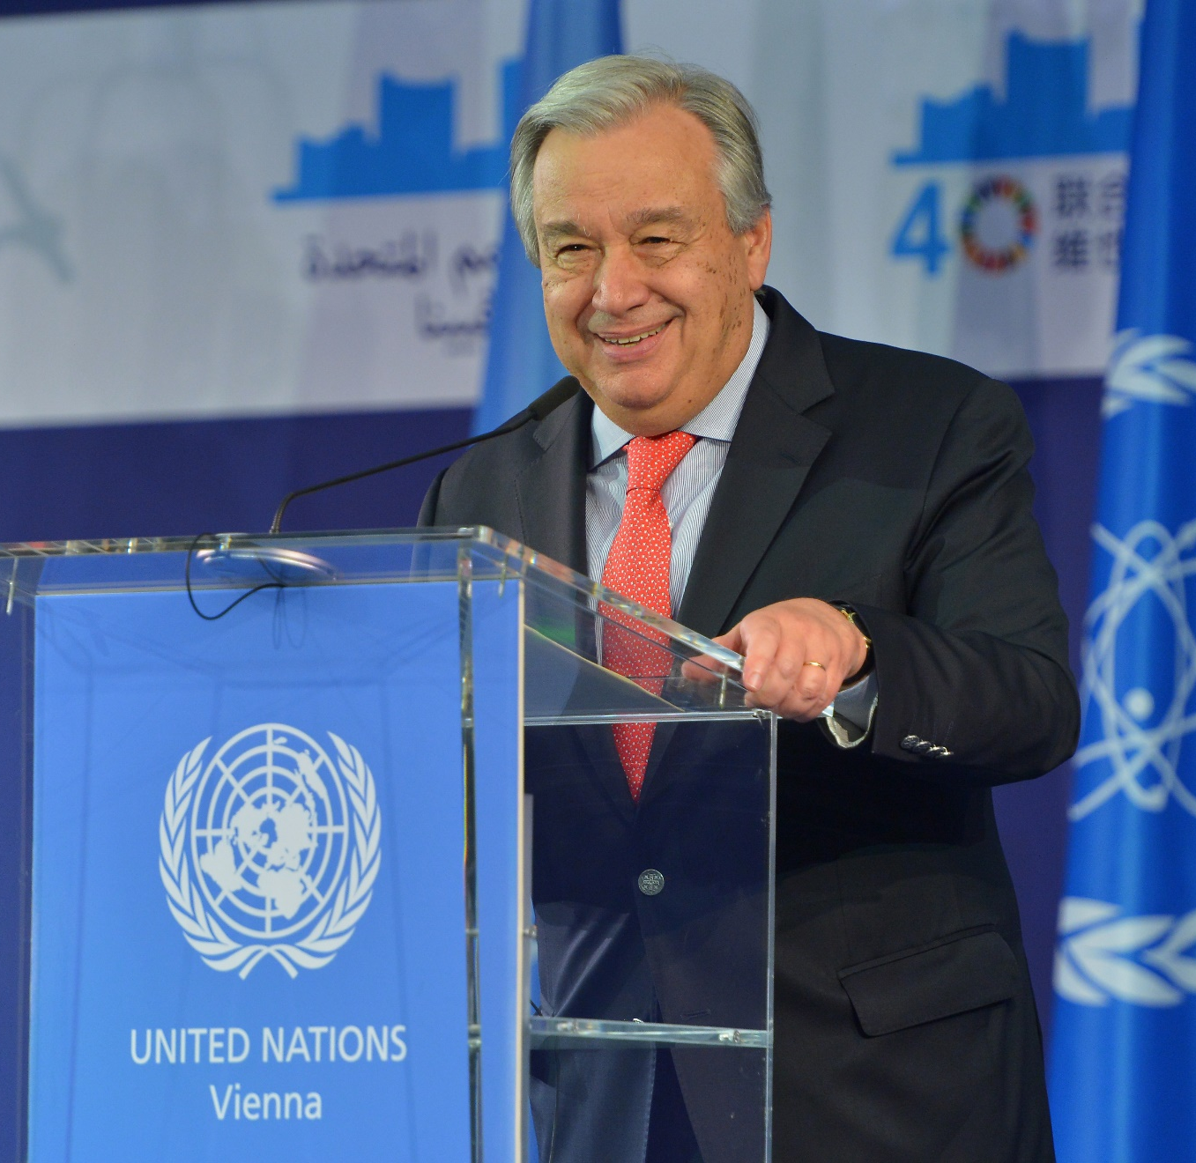
The Secretary-General of the United Nations
António Guterres, former Prime Minister of Portugal is the ninth Secretary-General and started his 5 year term in office on 1st January 2017.
The UN states he is the "chief administrative officer"
Notes:
Previous General-Secretaries: Boutros Boutros-Ghali, Kofi Annan, Ban Ki-moon. Length of term is discretionary but usually 5 years

Slide 14
The UN system/Family
UN
Funded by member states
Programmes and funds
Paid by voluntary contributions
Specialised agencies
Independent international organisations paid by voluntary and assessed contributions
UNICEF
UNESCO
UNDP
WHO
WFP
IMF
Notes:
United Nations Childrens Fund United Nations development programme United Nations food programme World Health Organisation United Nations Educational,Scientific and Cultural Organisation International Monetary Fund

Slide 15
Part 2: What the UN does in the world
The UN does many things, we will focus on two of them:
Maintain international peace and security
Promote sustainable development (SDGs)
Protect human rights
Deliver humanitarian aid
Uphold international law

Slide 16
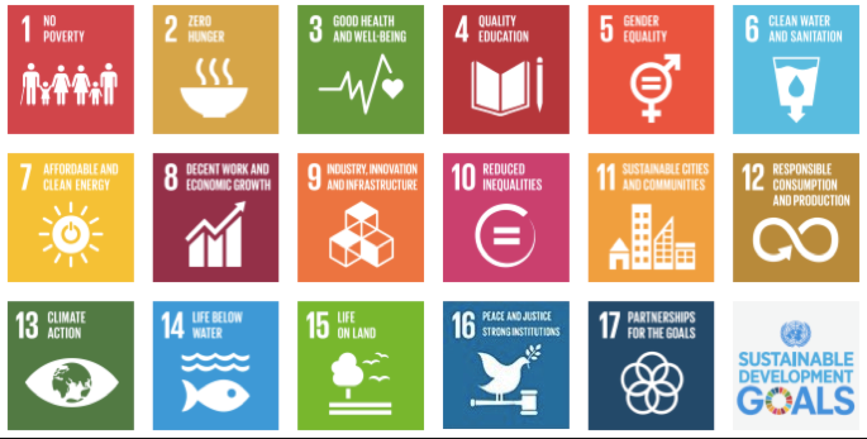
Sustainable Development: Sustainable Development Goals SDG
The SDGs adopted by all the member states “The blueprint to achieve a better and more sustainable future for all.” UN
Notes:
The SDGs were set in 2015 by the United Nations General Assembly and are intended to be achieved by the year 2030 “The 2030 Agenda for Sustainable Development, adopted by all United Nations Member States in 2015, provides a shared blueprint for peace and prosperity for people and the planet, now and into the future. At its heart are the 17 Sustainable Development Goals (SDGs), which are an urgent call for action by all countries - developed and developing - in a global partnership. They recognize that ending poverty and other deprivations must go hand-in-hand with strategies that improve health and education, reduce inequality, and spur economic growth – all while tackling climate change and working to preserve our oceans and forests.”

Slide 17
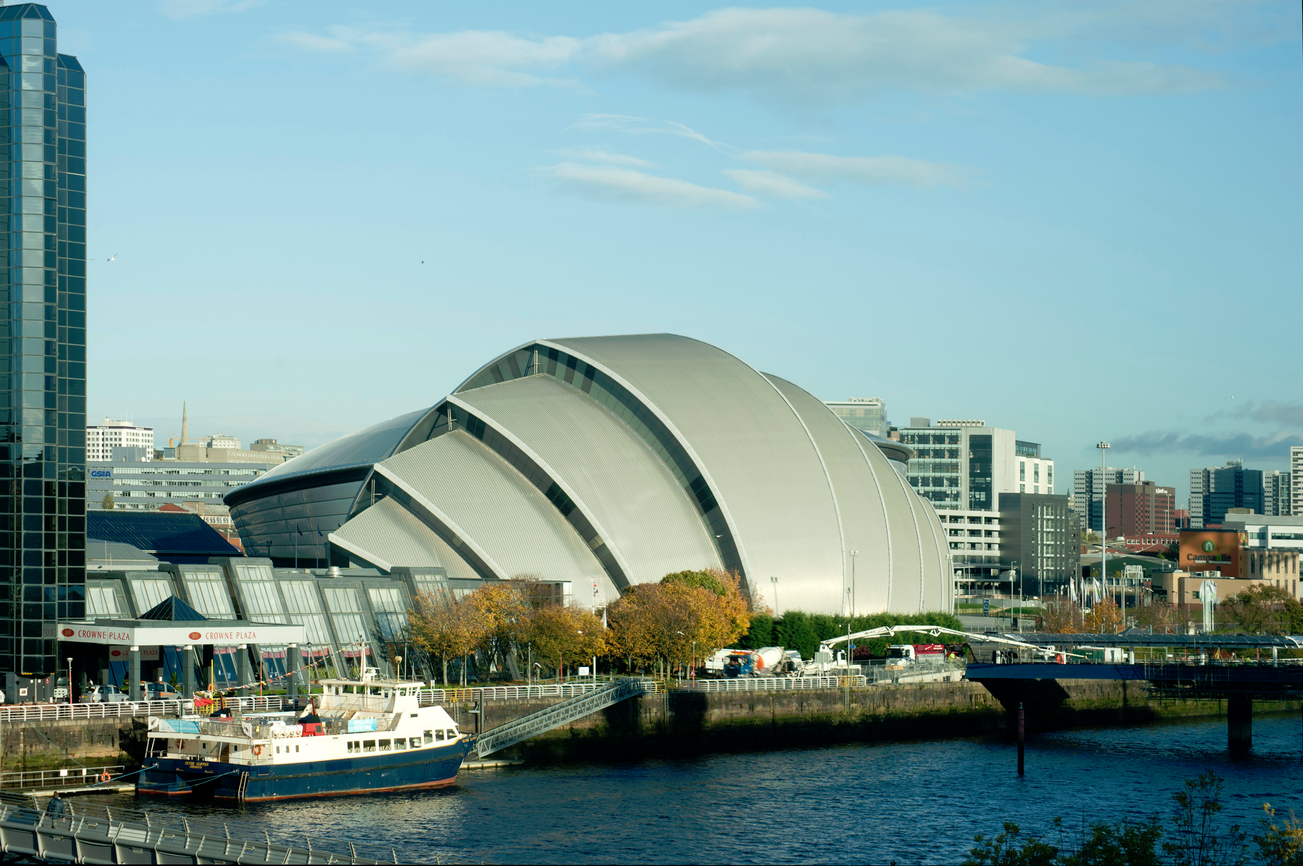
Sustainable Development: COP26 SEC Glasgow
On 1.11.21 -12.11.21 the COP (Conference of the Parties) meet in Glasgow to “Tackle Climate Change”
“By uniting behind a green recovery from coronavirus, which creates sustainable jobs and addresses the urgent and linked challenges of public health, climate change, and biodiversity loss, we can safeguard the environment for future generations”
https://ukcop26.org/uk-presidency/

Slide 18
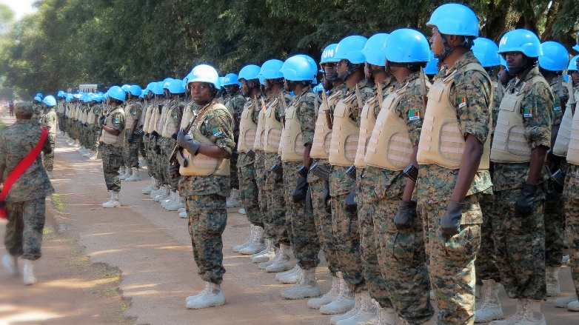
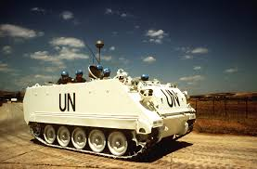
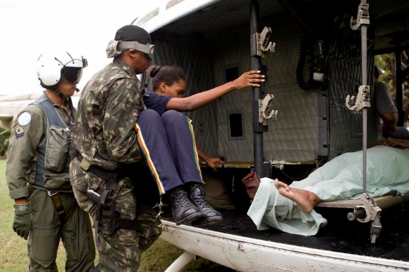
the maintenance of international peace and security
The UN tries reduce conflicts by:
Peace keeping and having peace keepers
UN member states send peacekeepers to areas of tension to keep the peace. They might:
protect civilians
provide security during elections
monitor peace processes
reinforce ceasefires so that negotiations can take place
prevent aircraft flying
over areas in a no-fly zone.

Slide 19
the maintenance of international peace and security
Sanctions
Restrictions or bans that are imposed on a country that is not acting in a way that the UN considers as correct.
“The Security Council can take action to maintain or restore international peace and security under Chapter VII of the United Nations Charter. Sanctions measures, under Article 41, encompass a broad range of enforcement options that do not involve the use of armed force”
https://www.un.org/securitycouncil/sanctions/information

Slide 20
the maintenance of international peace and security
Treaties
What is a treaty?
A treaty is…
…a binding formal agreement in international law. It is a contract between two or more groups, usually states or international organisations. They agree to the terms written in the document; it is an exchange of promises.
Can you think of some examples?
A UN treaty that became law on 22.1.21 for the countries who have ratified it, is the Treaty for the Prohibition of Nuclear Weapons
Notes:
Eg The Treaty of Versailles 1919, the Triple Alliance 1882, the Treaty of London 1839, The UN Charter, Concordats (Holy See/Vatican and sovereign state), the North Atlantic Treaty (1949)

Slide 21
To what extent is the UN effective?
"Together, through the UN, the world has eradicated smallpox, closed the ozone hole, and brought stability to war-torn countries; we’ve protected tens of millions of children from disease; given refugees help and hope; enshrined human rights into international law; and all countries have signed up to the collective promise of the Sustainable Development Goals.
The UN Foundation is committed to delivering on the promise of the United Nations. We are proud to carry it in our name. We are determined to see it succeed.
When we act together, change happens." UN Foundation

Slide 22
To what extent is the UN effective?
Think about its role:
Maintain international peace and security
Promote sustainable development (SDGs)
Protect human rights
Deliver humanitarian aid
Uphold international law
The UN gets countries talking to each other. It has been criticized for not being able to do enough but if it was stronger, would it lose co-operation?

Slide 23
Part 3: How the UN makes international laws

Slide 24
TReaties
Domestic law and international law are different. Domestic law applies to everyone within the country that makes the law.
Laws made by the UN are usually referred to as treaties. These international laws apply to the countries that ratify the treaty.
Ratifying a treaty is when a state gives its consent to be bound by it.

Slide 25
How is a treaty made?
The Treaty on the Prohibition of Nuclear Weapons has gone through the UN process to become law on 22nd January 2021
Treaty becomes law in the countries which signed it
People want change
UN
conference
Treaty ratified

Slide 26
Why did people want change?
The public in countries all over the world (sometimes called civil society) asked questions like:
What if there was an nuclear accident?
Is it right that 9 countries have nuclear weapons but the risks of having and using them affects everyone in the world? Is that global security?
This lead to an international UN conference where the TPNW was written and signed by 122 countries. The TPNW was then ratified by 50 countries in October 2020.

Slide 27
Why did people want change?
The new Treaty, TPNW, has emerged because previous nuclear weapons treaties that were designed to help limit the number of nuclear weapons and the number of states with nuclear weapons have had very limited success.

Slide 28
The Treaty for the Prohibition of Nuclear Weapons (TPNW)
Focuses on the humanitarian impact and the risks of having nuclear weapons in the world
122 countries agreed to the process to set up the treaty.
By February 2021 51 Governments had ratified the treaty and are therefore bound by it, making nuclear weapons illegal in these countries.
More countries will be ratifying the Treaty
- will the UK?

