Slide 1
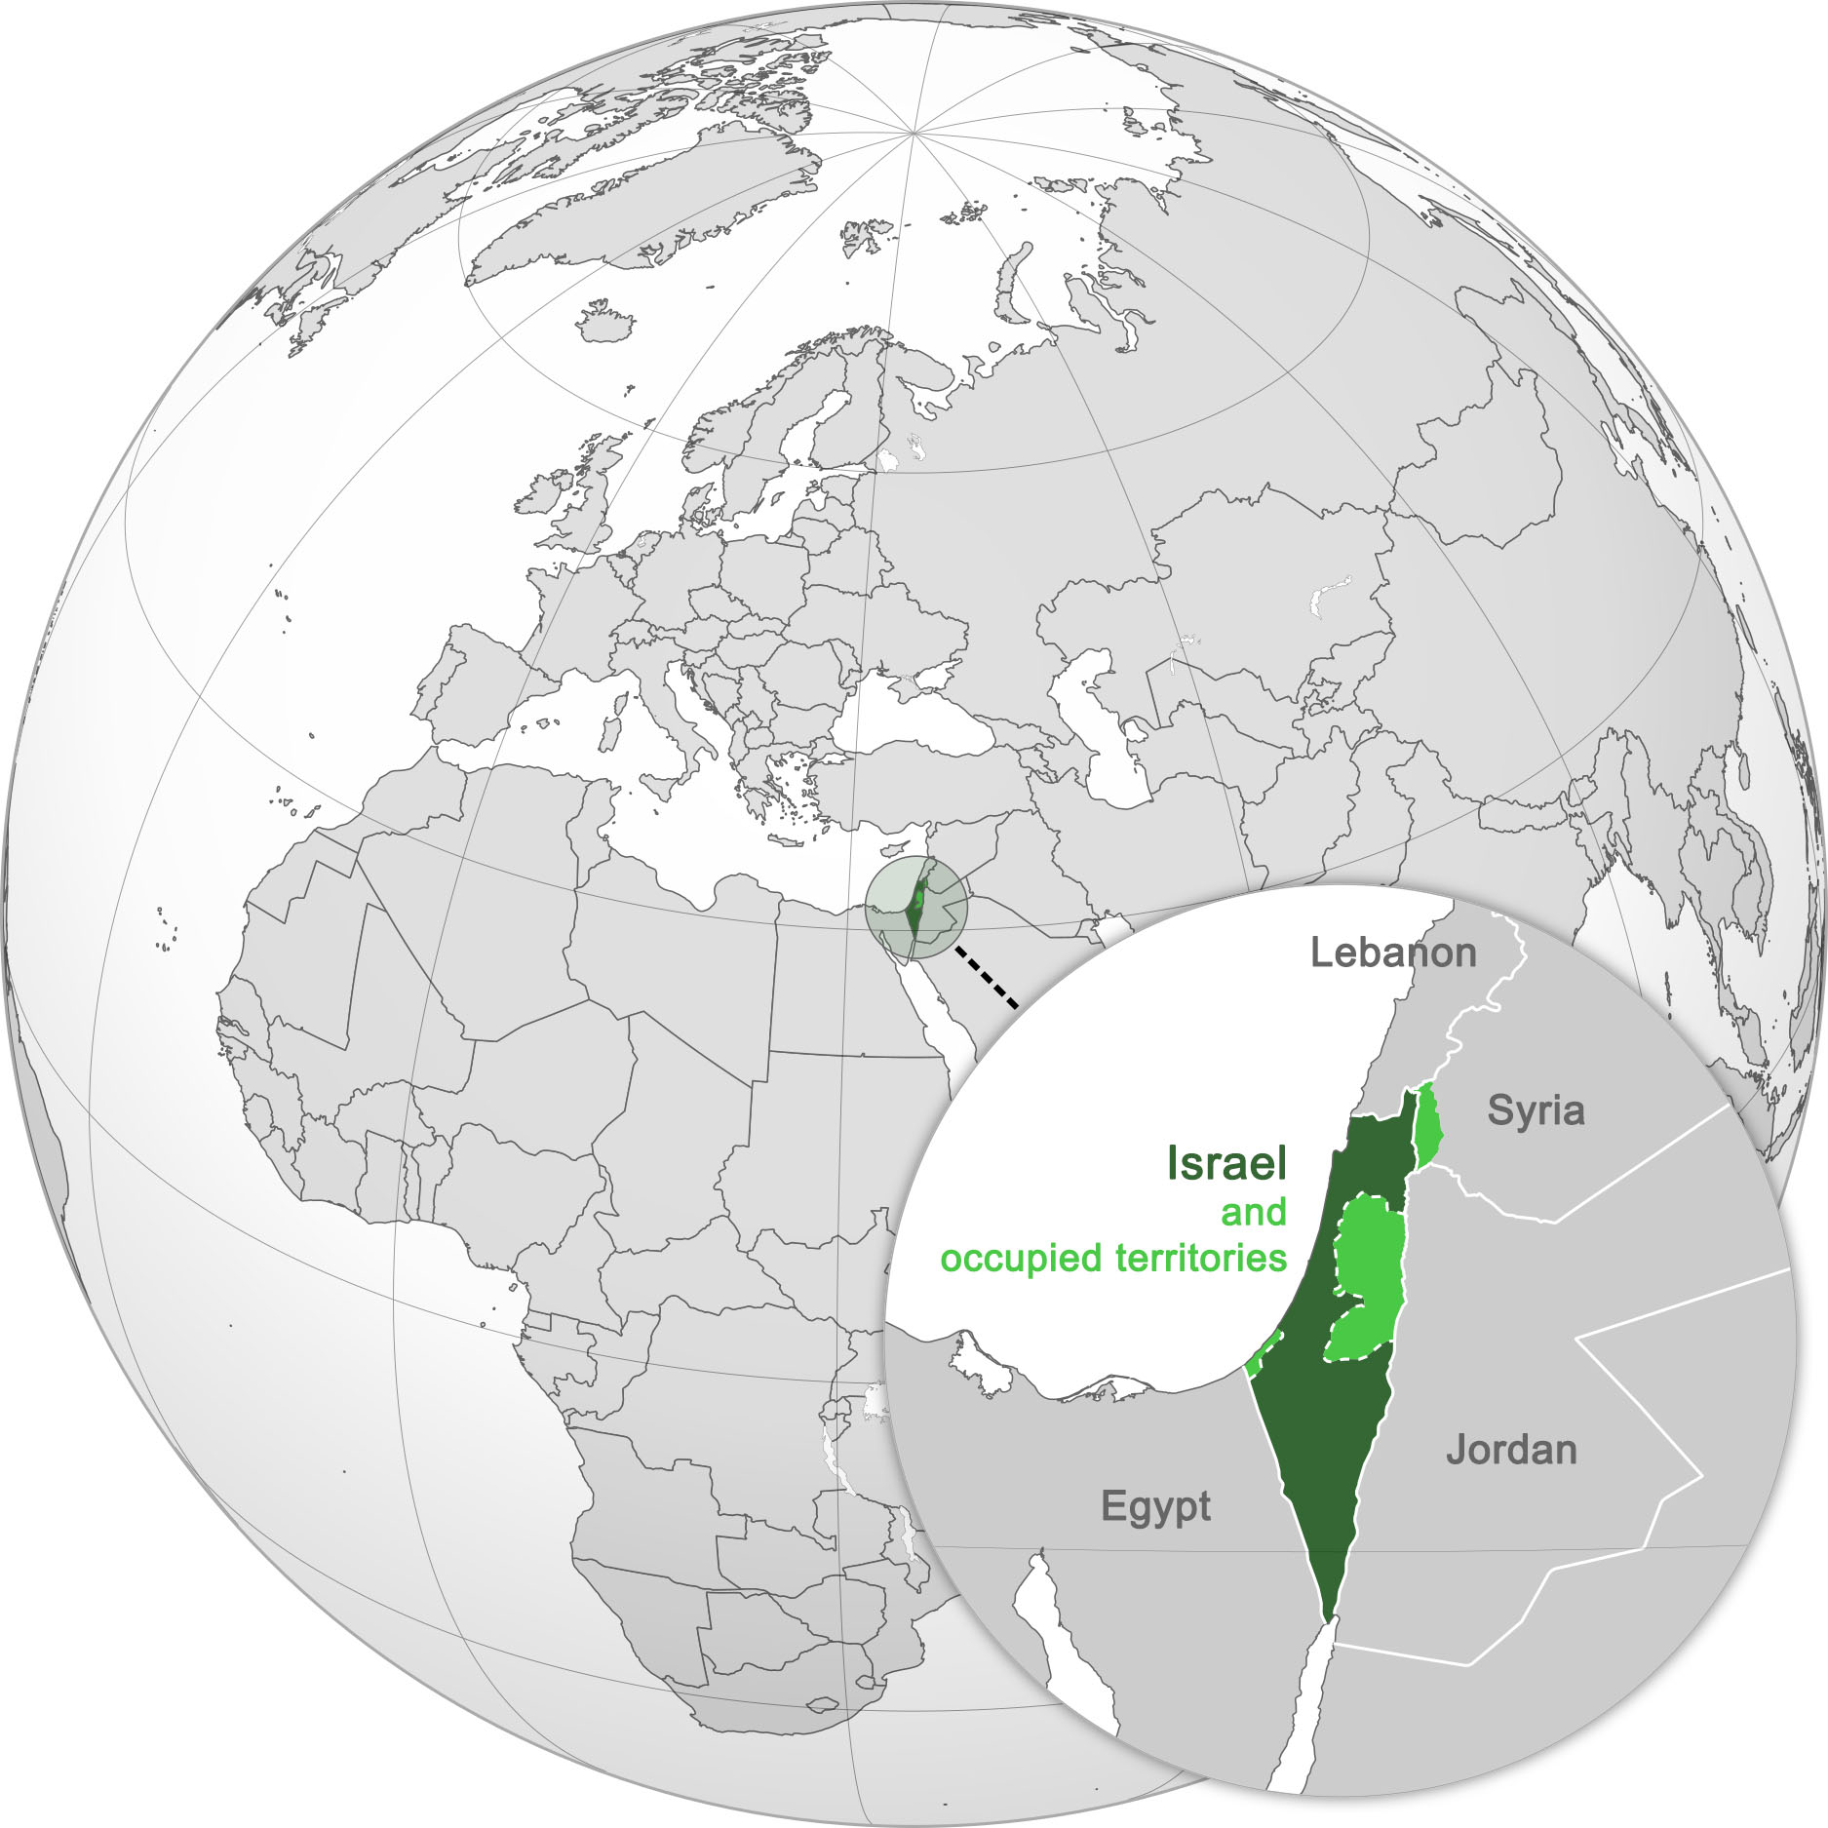
Nuclear Deterrence and
Israel’s Nuclear Weapons
Peace Education Scotland
www.peaceeducationscotland.org

Slide 2
Background about nuclear weapons
Some video links
What if We Nuke a City? - YouTube (approx. 9 mins) shows the destructive power of a nuclear bomb
Mutually Assured Destruction - YouTube (approx. 3 mins) ‘MAD’
Mutually Assured Destruction - Nuclear Fallout - YouTube (approx. 9 mins) includes the Cold War and Cuban Missile Crisis
Nuclear Explosions - Vimeo (approx. 3 mins)
The Nuclear Weapons Debate – Vimeo (approx. 2 mins)

Slide 3
What is ‘nuclear deterrence’?
Nuclear deterrence is the idea that possessing nuclear weapons prevents others from attacking because of the threat of devastating retaliation.
Many countries, including Israel, possess nuclear weapons.
States who possess nuclear weapons claim that this deters other states from attacking them.
Deterrence, threat and credibility in the nuclear age - Youtube (approx. 4mins)

Slide 4
What is ‘nuclear deterrence’? (contd.)
Despite having nuclear weapons, states that have them have been attacked or drawn into a war.
The Falklands War when Argentina attacked the British dependency, the Falkland Islands, is a good example:
The Falklands War – Youtube Short (approx. 1 min)
Also:
Why Nuclear Deterrence Does Not Work – Youtube (approx. 7 mins)

Slide 5
Case Study: Israel’s Nuclear Weapons and the Yom Kippur War
The Yom Kippur War (1973) Egypt and Syria launched a surprise attack on Israel in a bid to regain lost territory. It is generally agreed that both countries knew that Israel possessed nuclear weapons.
Yom Kippur War - YouTube (approx. 3mins)

Slide 6
Exploring the Dangers and Destabilising Influence of Nuclear Weapons
False Sense of Security?
Can having nuclear weapons create a false sense of security?
The possession of nuclear weapons does not give Israel a sense of security at all, false or real. The public live with an overarching sense of insecurity, despite having nuclear weapons.
Poll after poll reveals that Israelis live in a constant state of fear from their neighbours and the position of nuclear weapons does not lessen that sense of fear.
Being in that sense of fear does not of course mean that Israelis want to give up nuclear weapons but equally it contributes nothing to a sense of security.
.
Why might Israel want to have nuclear weapons?

Slide 7
Exploring the Dangers and Destabilising Influence of Nuclear Weapons (contd.)
  Regional Tensions:
  Israel’s possession of nuclear weapons has led to increased tensions in the Middle East. This may encourage other countries, such as Iran, to develop a nuclear weapons programme. The more countries that have nuclear weapons (nuclear proliferation) the more difficult it is to pursue international nuclear arms treaties.
  Accidents and Miscalculations:
  Possessing nuclear weapons increases the risks of accidents, misunderstandings, or the possibility of nuclear weapons falling into the wrong hands, which could have catastrophic consequences. The history of the Cuban Missile Crisis – YouTube (approx. 5mins)
  Escalation:
  Possession of nuclear weapons have not always prevented smaller conflicts or tensions from escalating in different regions. An example to consider: India and Pakistan - Youtube (approx 9mins)

Slide 8
Summary
Nuclear deterrence does not always prevent conflict.
Nuclear weapons can increase the risk of war, accidents, and regional instability.

Slide 9
Background into the conflict
Short infographic video about Israel-Palestine
The Israel-Palestine conflict: a brief, simple history - Youtube (approx. 10mins)
A 10 minute video history of Israel-Palestine
Rory Stewart Attempts to Explain the History of Israel-Palestine in 10 Minutes - YouTube (approx. 10mins)

Slide 10
Update: Iran - Israel War, June 2025
  Often referred to as the Twelve Day War
  Background - During the Gaza Conflict and the wider Middle Eastern Crisis, an armed conflict began on 13th June 2025 when Israel launched a surprise attack on Iran.
  Key military and nuclear facilities were targeted, and several of Iran’s military leaders, nuclear scientists, and politicians were killed.
  Iranian Response - Iran retaliated with missile and drone strikes against Israeli cities and military sites. The Houthis, allied to Iran, also fired several missiles at Israel.
  Further Escalation - On the ninth day of the conflict, the USA bombed three Iranian nuclear sites in ‘Operation Midnight Hammer’. Iran retaliated by firing missiles at a US Base in Qatar.
  Ceasefire - Under pressure from the USA, on 24th June 2025, Israel and Iran agreed to a ceasefire.

