Slide 1
Who represents me?
We live in a democracy. We elect people to represent us.
In Scotland we have elected local councillors, Members of the Scottish Parliament and Members of Parliament to represent us.

Slide 2
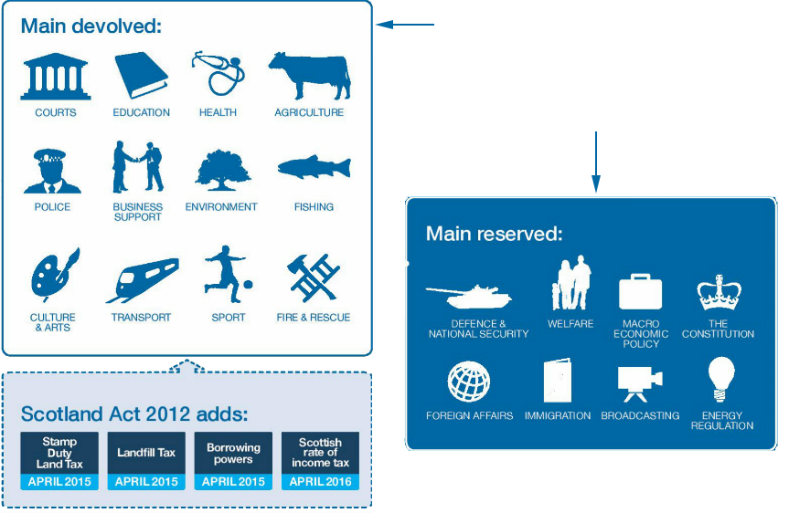
Devolved or Reserved?
Notes:
Image from https://www.gov.uk/government/news/scottish-independence-referendum-whats-next

Slide 3
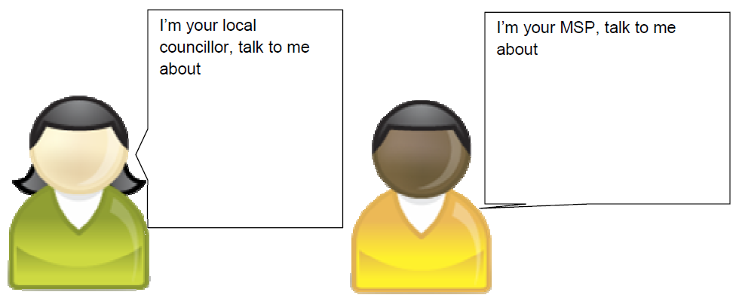
Who represents me?
Sometimes issues can be dealt with at more than one level.
For example Education can be dealt with at a local council level, or a Scottish Parliament level.
Education
Care for the elderly
Hospitals
Police
Graffiti
Care for the elderly
Council tax
Education
Bin collections
Cycle paths

Slide 4
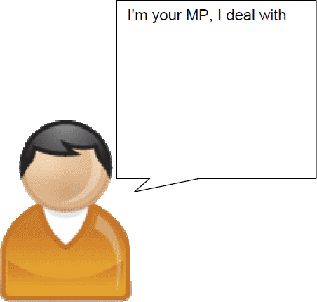
Who represents me?
Defence
UK Laws
Nuclear weapons
Employment

Slide 5
Who represents me?
Nuclear Weapons are a reserved matter however nuclear issues relating to them could be dealt with at a local council level or a Scottish Parliament level.
concerns about nuclear convoys on public roads
radioactive pollution in Loch Long
nuclear incident emergency procedures
UK nuclear weapons based at Faslane
concerns about nuclear convoys on public roads
setting up a Peace Garden
nuclear incident emergency procedures
information on Nuclear Free Local Authorities

Slide 6
Who represents me?
concerns about nuclear convoys on public roads
nuclear incident emergency procedures
UK nuclear weapons based at Faslane

